Slide 1
Indoor Object Detection and Identification through Webcam
18BCE2511- RITIKA MANDAL
18BCI0148- JAI KATHURIA
18BCI0131 - RAGHAV SOMANI
Demo-LiNK
https://drive.google.com/file/d/1fX93wQ0MLMWkGjuVyds1U99UAr3hHJd7/view?usp=sharing

Slide 2
INTRODUCTION
When we look at images or videos, we can easily locate and identify the objects of our interest within moments. Passing on of this intelligence to computers is nothing but object detection - locating the object and identifying it. Object Detection has found its application in a wide variety of domains such as video surveillance, image retrieval systems, autonomous driving vehicles and many more. Computer vision has a lot of interesting applications and object detection is one of the most interesting application. With the advance computer vision techniques, the objects present in the images can be identified in seconds with great accuracy. Hundreds of images can be processed in a few minutes to detect objects in those images. There are many algorithms available now through which this object detection can be performed very fastly. YOLO is one of these popular object detection methods.

Slide 3
YOLO vs. SSD
YOLO (You Only Look Once) system, an open-source method of object detection that can recognize objects in images and videos swiftly whereas SSD (Single Shot Detector) runs a convolutional network on input image only one time and computes a feature map. SSD is a better option as we are able to run it on a video and the exactness trade-off is very modest.
SSD is a healthier recommendation. However, if exactness is not too much of disquiet but you want to go super quick, YOLO will be the best way to move forward. First of all, a visual thoughtfulness of swiftness vs precision trade-off would differentiate them well.
While dealing with large sizes, SSD seems to perform well, but when we look at the accurateness numbers when the object size is small, the performance dips a bit.

Slide 4
DATASET
> FOR COCO:
The cfg and the weight files can be downloaded from github. It provides a vast library for object detection which is up-to-date and well maintained.
> FOR YOLO:
The cfg and the weight files can be downloaded from the official yolo website. You can test different version recommend are YOLOv3-320 and YOLOv3-tiny. And the names data file can be downloaded or created on its own.

Slide 5
PROPOSED WORK
FOR WEBCAM IMAGE CLASSIFIER
The webcam is used to capture a screenshot from video capture.
The received image is flattened to create a 1-D array of pixels.
The flattened array is fed into the YOLO algorithm network.
The YOLO algorithm makes a prediction based on confidence values as to which object is most likely represented by the capture.
The object with the highest confidence value is given as output.
We can employ two different types of algorithm to object detection namely Single shot Detection and YOLO. Single Shot detection uses a Convolution network to perform object detection and thus takes a lot longer to give significant output, since we want out application to be real-time we employed the YOLO algorithm for fast processing.

Slide 6
SINGLE SHOT DETECTION
SSD has two components: a backbone model and SSD head. Backbone model usually is a pre-trained image classification network as a feature extractor. This is typically a network like ResNet trained on ImageNet from which the final fully connected classification layer has been removed. We are thus left with a deep neural network that is able to extract semantic meaning from the input image while preserving the spatial structure of the image albeit at a lower resolution. For ResNet34, the backbone results in a 256 7x7 feature maps for an input image. We will explain what feature and feature map are later on. The SSD head is just one or more convolutional layers added to this backbone and the outputs are interpreted as the bounding boxes and classes of objects in the spatial location of the final layers activations.

Slide 7
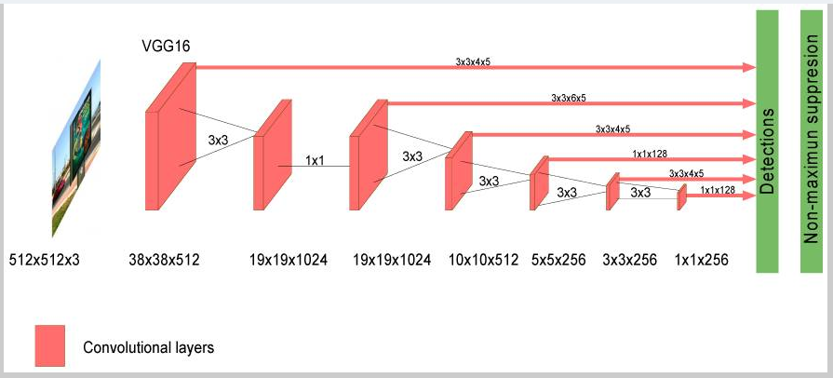
LAYER ARCHITECTURE OF SSD

Slide 8
YOLO
YOLO was inspired by GoogleNet and the idea was applying a unique neural network to the full image, where the network divides the image into regions and simultaneously predicts bounding boxes and probabilities for each region. These bounding boxes are weighted by the predicted probabilities. YOLO splits an image into a N × N grid, where each cell predicts only one object. This prediction is given as a fixed number of boundary boxes where each box has its confidence score. It detects one object per grid cell regardless of the number of boxes by applying a non-maxima suppression algorithm. YOLO generally uses ImageNet for parameter pre-training, and then uses target detection data sets for target recognition training. Several improvements on YOLO architecture have been proposed (i.e., YOLOv2 and YOLOv3 versions) which increased the detection accuracy while keeping a very high detection speed.

Slide 9
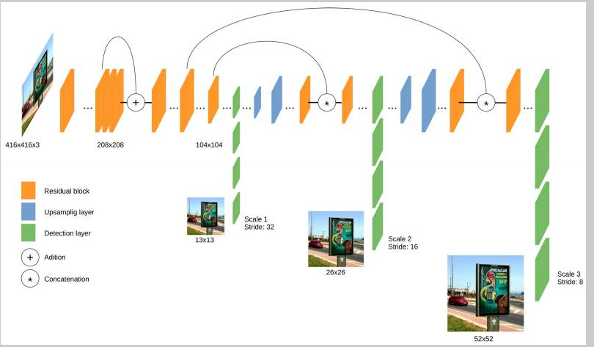
LAYER ARCHITECTURE OF YOLO

Slide 10
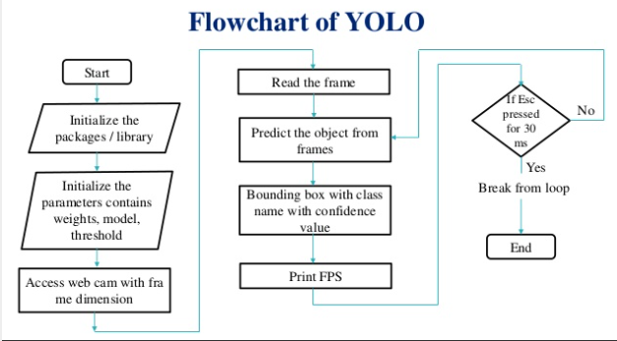
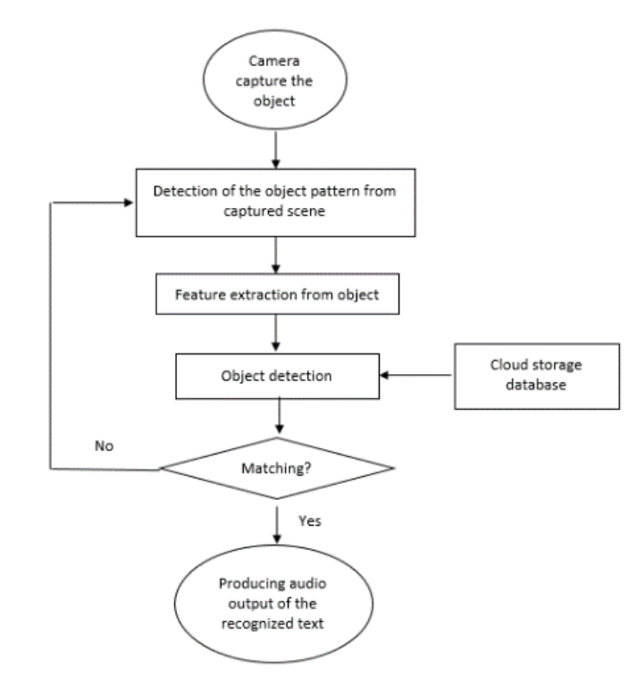
ALGORITHMS USED
You Only Look Once (YOLO) SINGLE SHOT DETECTOR(SSD)

Slide 11
TOOLS/ TECHNOLOGY
Datasets can be acquired from :
Github
Kaggle
To create the Detector we are using following tools:
Python 3 (OpenCV library)
Sublime Text / VSCode
Javascript
ML5.js Library

Slide 12
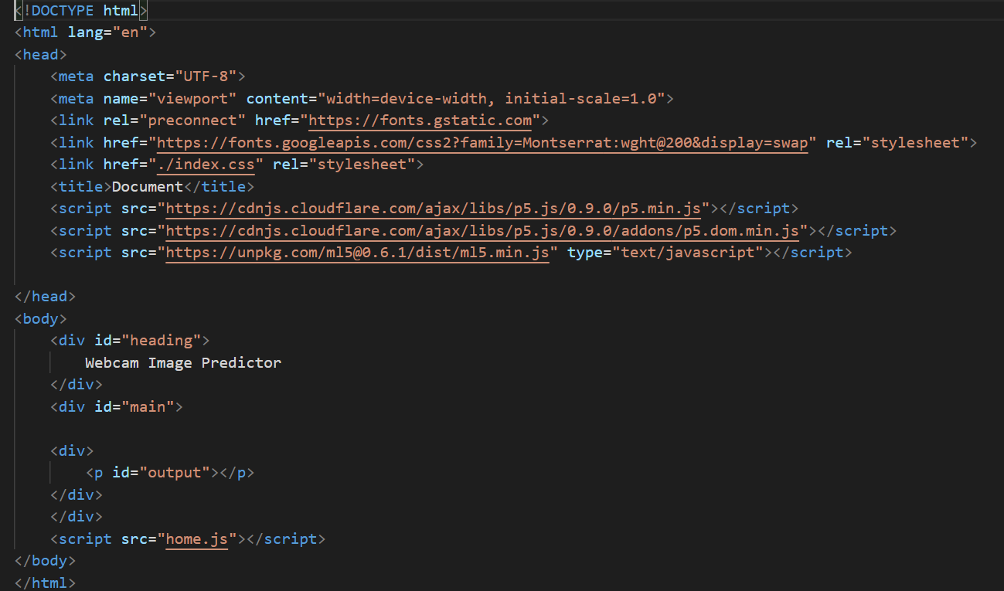
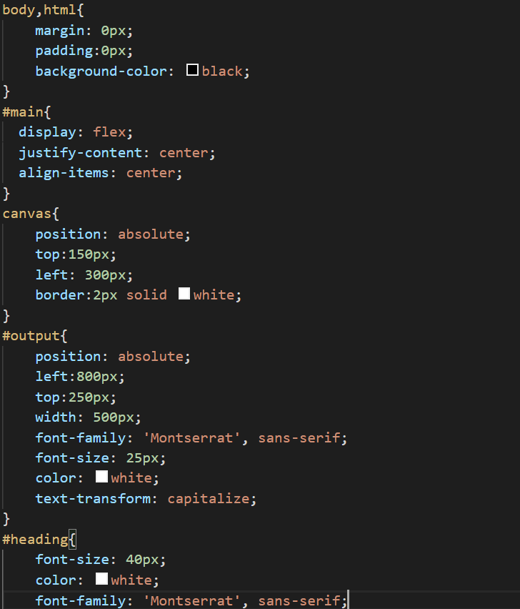
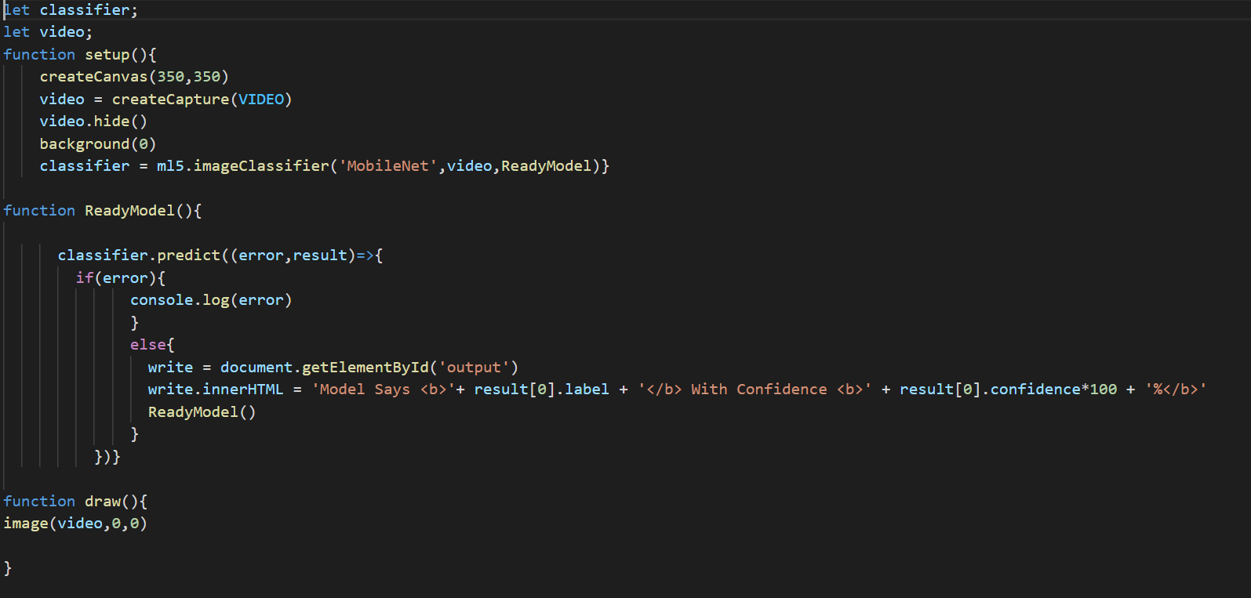
SAMPLE WEBSITE CODE

Slide 13
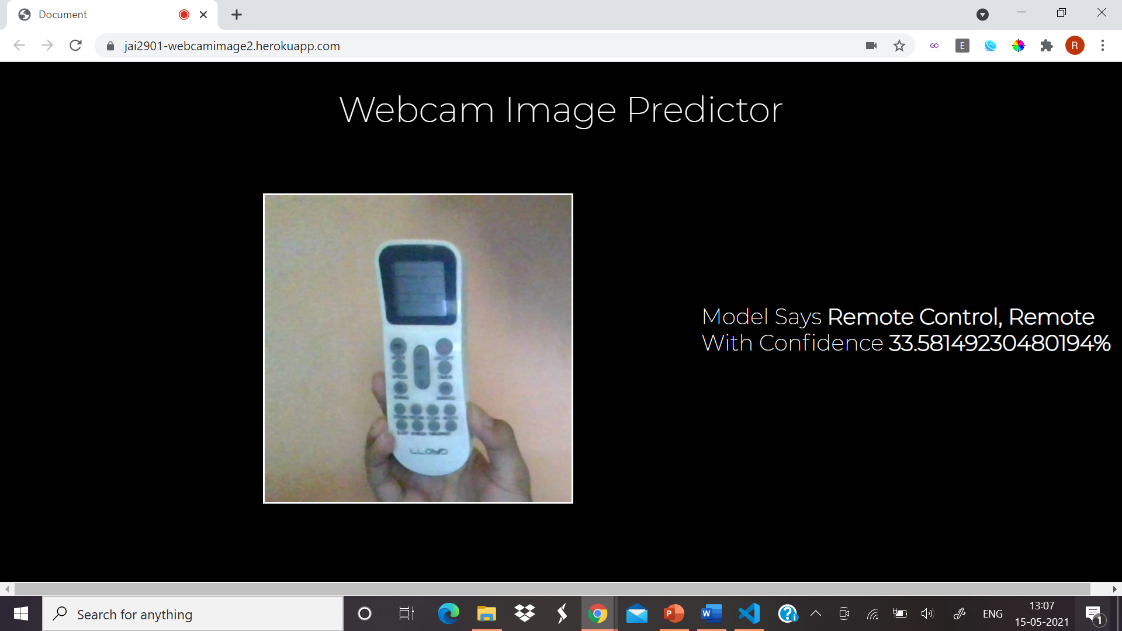
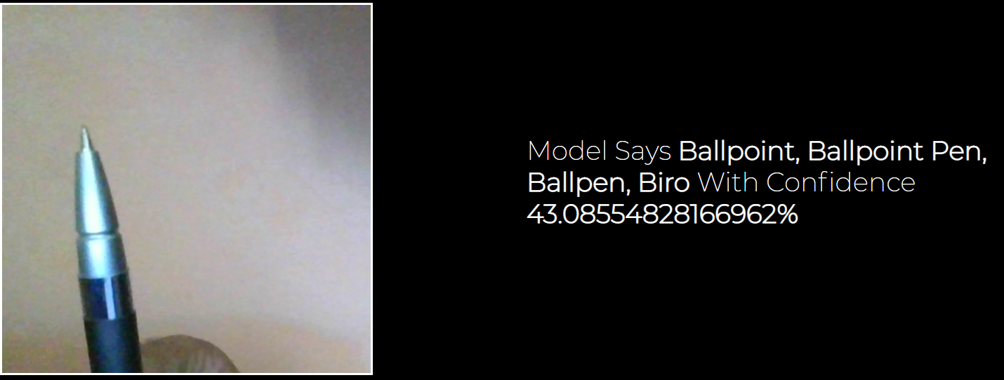
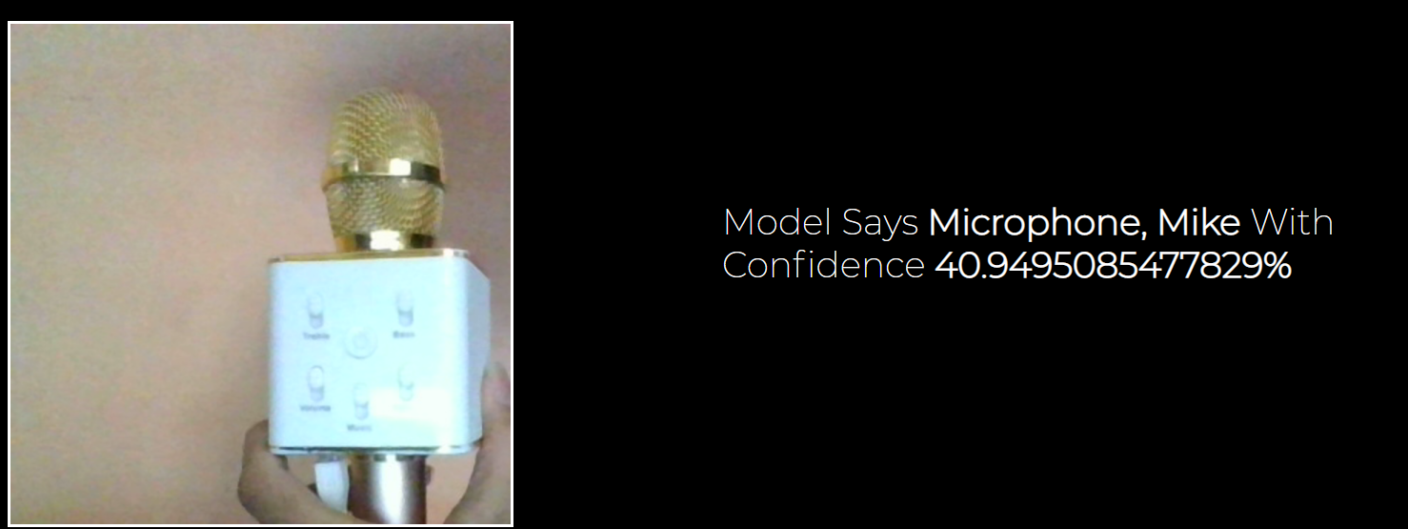
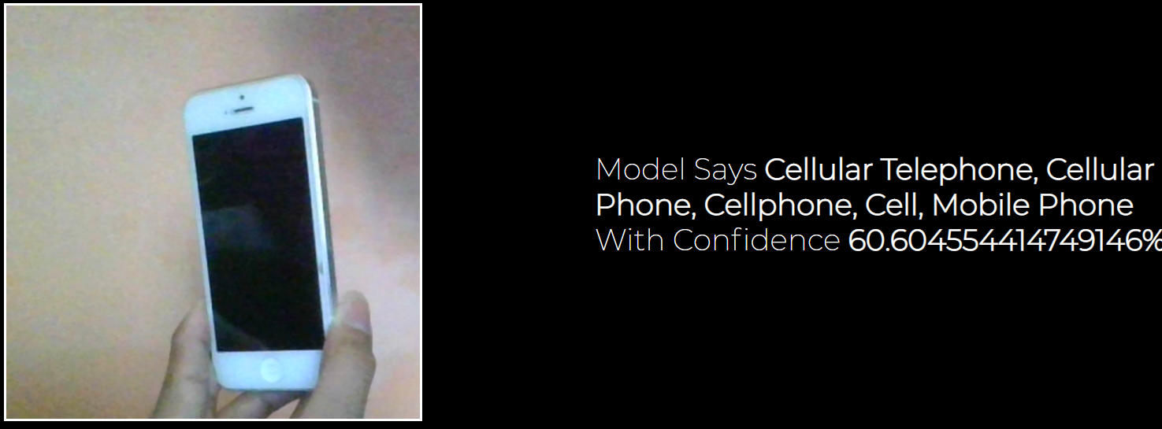
SSD

Slide 14
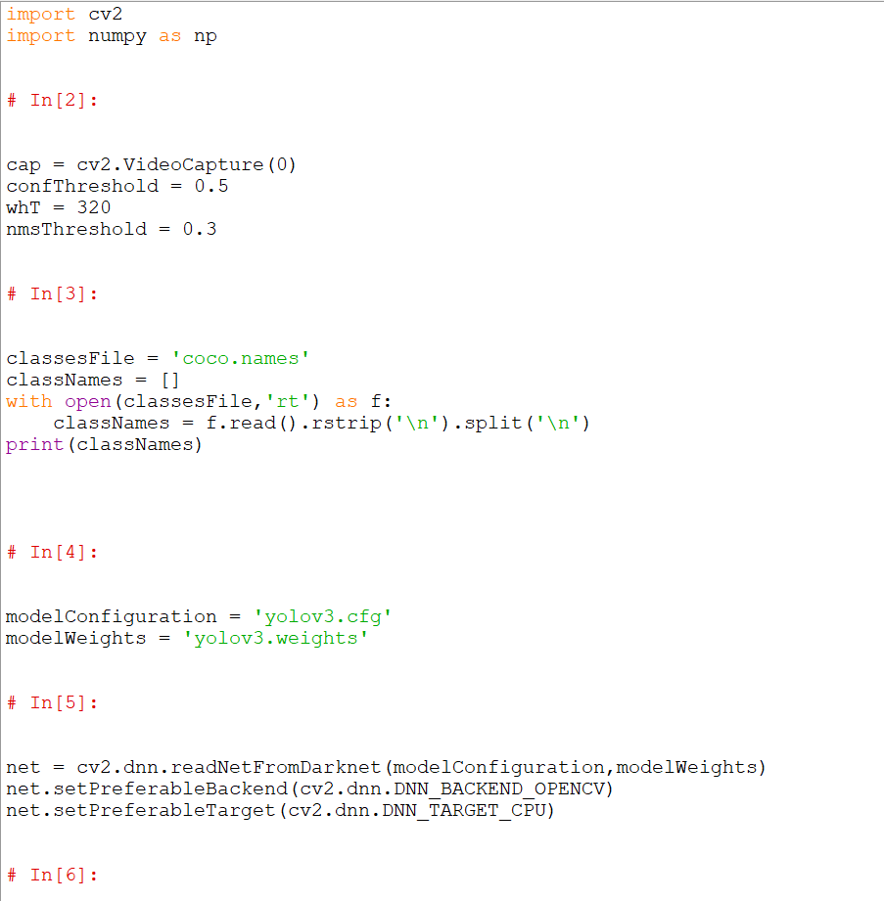
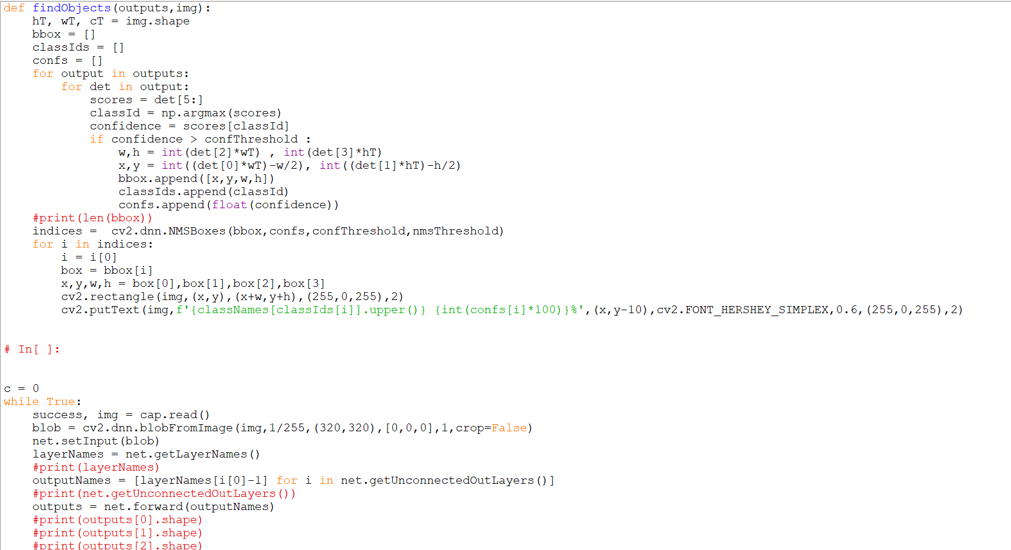
SAMPLE MAIN CODE

Slide 15
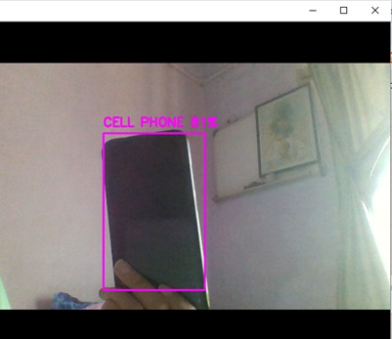
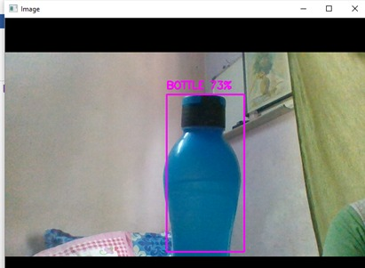
YOLO ALGORITHM

Slide 16
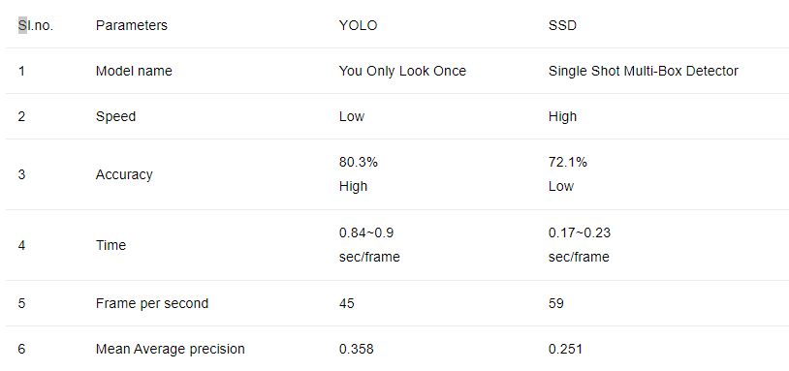
SUMMARY AND FINDINGS

Slide 17
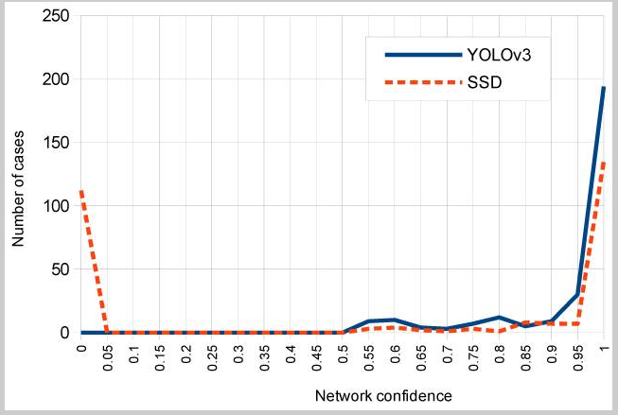
Note that for YOLOv3 most cases correspond to a high confidence value between 0.95 and 1, while for SSD the most returned confidence values on detections are distributed in ranges between 0.95 and 1 (first place) and between 0 and 0.05 (second place).

Slide 18
CONCLUSION
In recent years, deep learning based object detection has been a major focus in research due to its high learning ability and interest in handling constraint, scale transformation, and context switches. So from the above discussion, we can state that the use of the YOLO Model in
real life can greatly benefit many organizations. Just as we are probably aware that Yolo would make a marvelous impact in commercial and industrial sectors, as one of the most promising models, this algorithm is generalized to outperform various strategies between natural and various fields from object detection. The purpose of the algorithm is to classify artifacts that use a solitary neural network. The algorithm can be easily rendered and directly trained on a complete image. Above discussed regional strategies restrict the classifier to one region. In predicting borders, YOLO hits the entire picture. Moreover, in backgrounds, it predicts less constructive outcomes. This algorithm is much easier and simpler to use in real time than other classifier algorithms.

